Slide 1

GOODIE FOODIE
Presented By:
TANISHQ CHAUHAN (2100681520050)
ARYAN RASTOGI (2100681520012)
AKSHAT BALIYAN (2100681520005)
DIGVIJAY SINGH (2100681520018)
Under the Guidance of:
AJAY SHAH SIR
Department of Computer Science & Engineering
(ARTIFICIAL INTELLGENCE)
Meerut Institute of Engineering & Technology, Meerut (U.P.)
Notes:
₁

Slide 2

Presentation Outlines
Introduction
Research/Study Gap
Problem Statement
Objectives of the study
Methodology
DFD/Flow chart related to study
Hardware & Software to be used
References

Slide 3
Introduction
The project entitled “food order site" is an offline project for ordering food. The main objective of developing this project is to order food This application will greatly simplify and speed up the food ordering system . The mam aim of the project is to provide the food to the customers in a simple and accurate way. This project is useful for customers those have no time to go outside for eating food . By this system customer can easily get the food by entering their desired location and their current location.by our site customers can get food At affordable price and good quality food at their door step with no problem .

Slide 4
Problem Statement
In current time everyone has not time to go and buy food for himself so our site is a good option for them to order food without go out and use their time to do some work . They can eat their food at any time any where with out problem .

Slide 5
Objectives of the study
The main objective or the project is to provide food at the door with out any problem
This project IS useful for customers for getting their food in simple manner.
By online ordering food one can save their time and energy.
The system is Intended for public. One can order their food with out physical presentation
Earlier people used to avoid the restaurant because of rush and waste of time
There were long lines restaurant that were time-consuming
Ordering food via mobile phone directly to restaurant is not efficient and reliable.
But the time has changed, There is lot of people always hurry like student and cooprate employer who cant waste their time .
No last minute rush to find the restaurant or other outlet to eat
It also helpful to expand the business for restaurant employer .

Slide 6
Methodology
The system of collecting data for research project is known as research methodology. The data may be collected for either theoretical or practical research for example management research may be strategically conceptualized along with operational planning method and change management. Information which was used for this study was carried out by oral interview.

Slide 7
Choice of Methodology
For any project to be completed, it has to go through stages called Development Life Cycles. System Development Life Cycle (SDLC) is the process of understanding how an Information System (IS) can support business needs, designing the system, building it and delivering it to users. The SDLC composes of four phases: Planning, Analysis, Design and Implementation.

Slide 8
Choice of Methodology
In order for this project to be developed, the methodology that will be used is the System Structured Analysis and Design Methodology. The SSADM is classified as a Waterfall Development. With Waterfall Development, analyst and users proceed sequentially from one phase to the next and each phase can be mapped out and evaluated (Hevner, 2004).

Slide 9
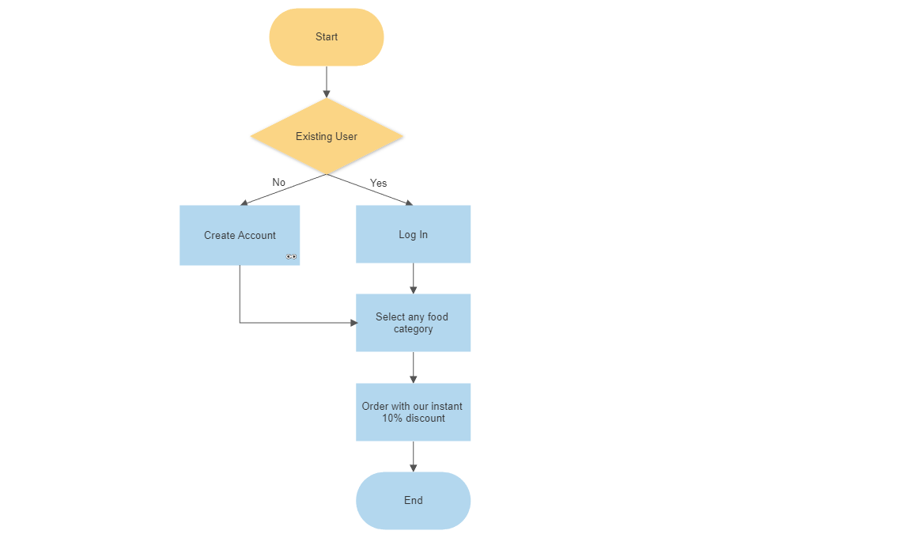
DFD/Flow chart of the study

Slide 10
Hardware/Software to be used
HARDWARE REQUIREMENTS:
Processor- 12 gen intel i5
RAM- 16GB
GRAPIC CARD- 3060 TI 12GB V RAM
SOFTWARE REQUIREMENTS:
• Windows 11
• HTML, CSS,JAVA SCRIPT
• VISUAL STUDIO CODE

Slide 11
References
https://www.linkedin.com/learning/paths/become-a-full-stack-web-developer - This is the LinkedIn Learning course that helped us understanding the basics of frontend web development and build our project website.
https://www.w3schools.com/ - w3schools is a famous coding website that provides solutions to soo many coding related problems. This also helped us to create our website.

Slide 12
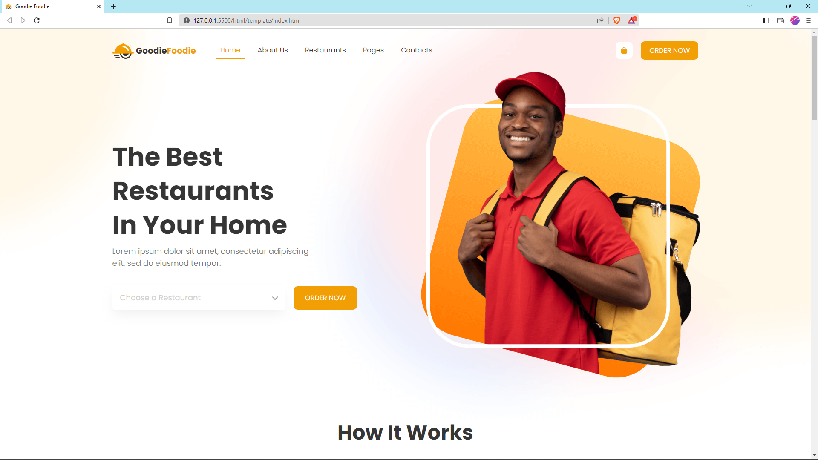
Output Screen – Home tab

Slide 13
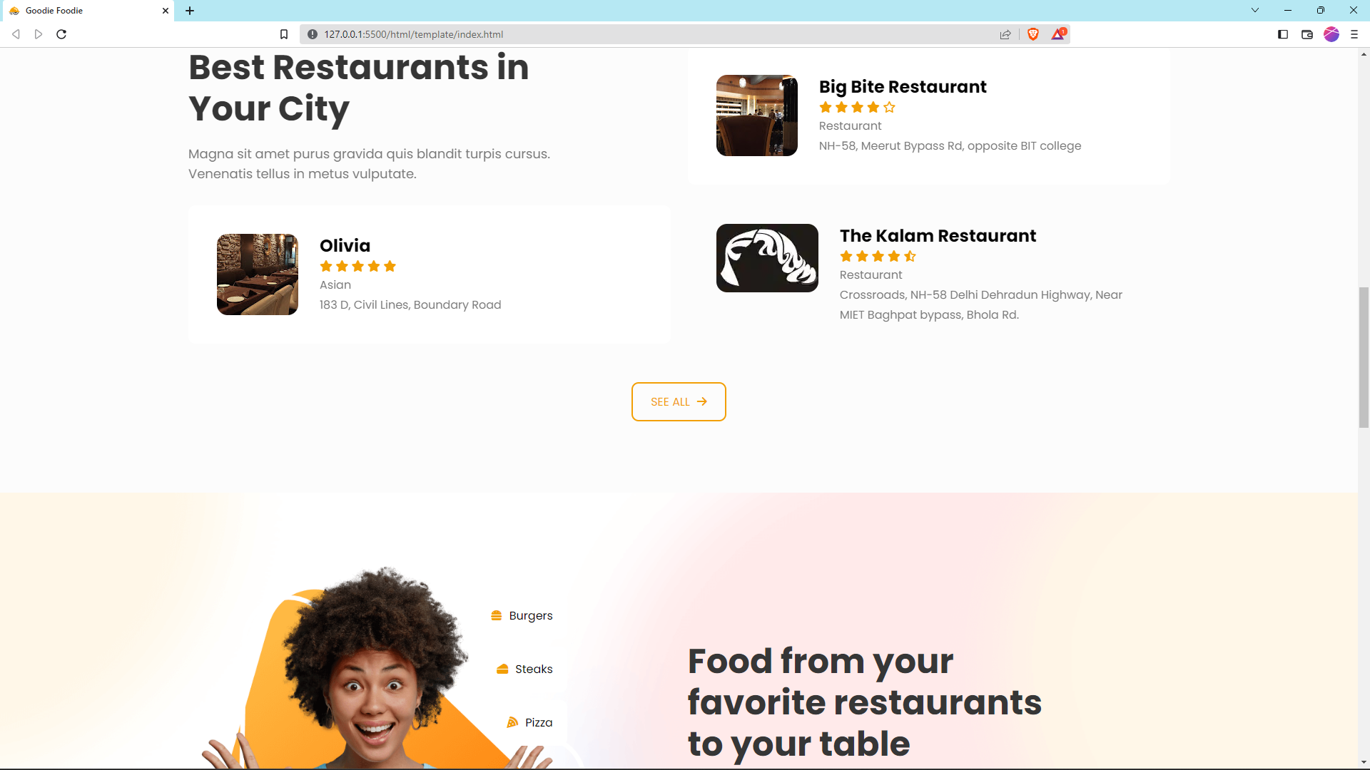

Slide 14
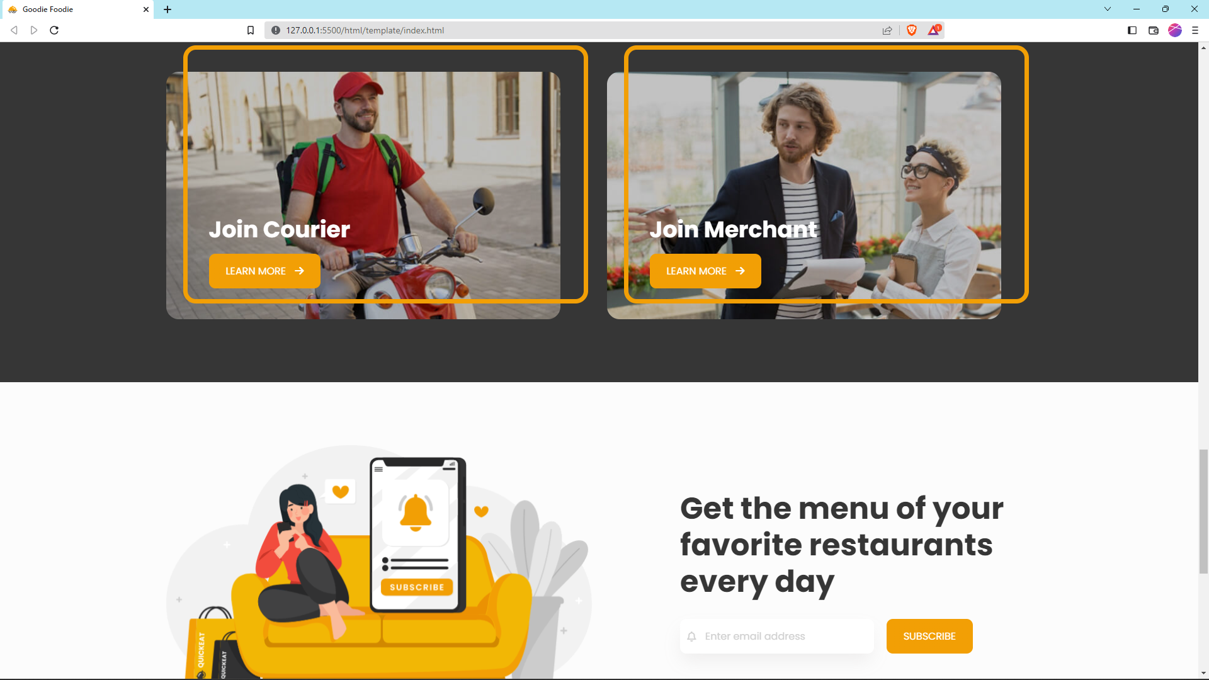

Slide 15
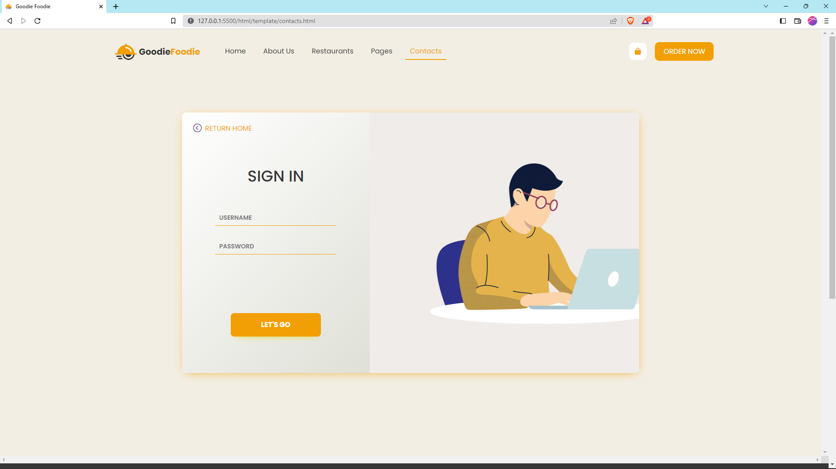
Contact Page

Slide 16
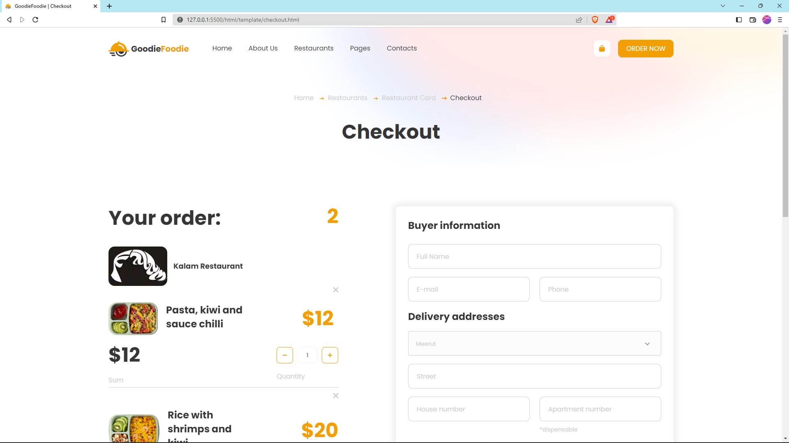
Checkout Page

Slide 17
